Slide 1
State Transition Testing

Slide 2
State Transition Testing is a type of software testing which is performed to check the change in the state of the application under varying input. The condition of input passed is changed and the change in state is observed.
State Transition Testing is basically a black box testing technique that is carried out to observe the behavior of the system or application for different input conditions passed in a sequence. In this type of testing, both positive and negative input values are provided and the behavior of the system is observed.
State Transition Testing is basically used where different system transitions are needed to be tested.

Slide 3
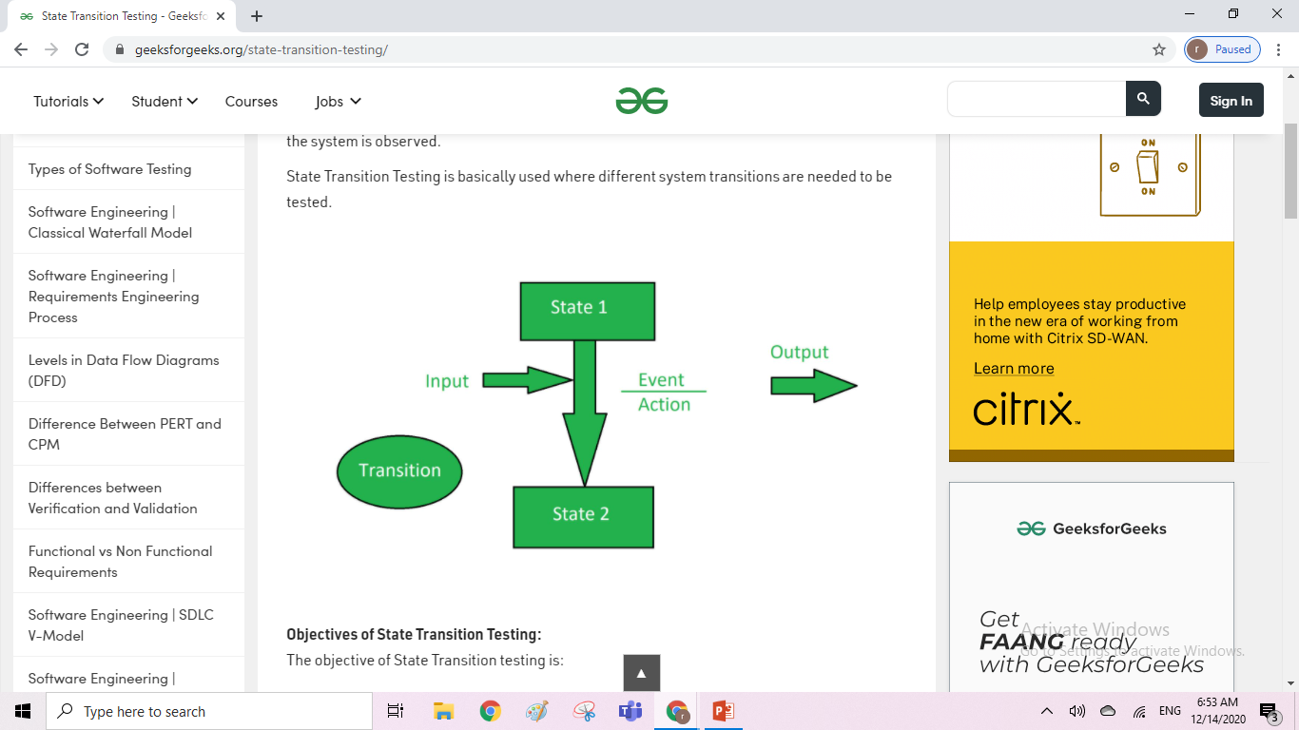

Slide 4



Here are 4 main components of the State Transition Model as below
1) States that the software might get
2) Transition from one state to another
3)Events that origin a transition like closing a file or withdrawing money
4) Actions that result from a transition (an error message or being given the cash.)

Slide 5
The objective of State Transition testing is:
To test the behavior of the system under varying input.
To test the dependency on the values in the past.
To test the change in transition state of the application.
To test the performance of the system.

Slide 6
When to Use State Transition?
This can be used when a tester is testing the application for a finite set of input values.
When the tester is trying to test sequence of events that occur in the application under test. I.e., this will allow the tester to test the application behavior for a sequence of input values.
When the system under test has a dependency on the events/values in the past.

Slide 7
State Transition Diagram and State Transition Table
There are two main ways to represent or design state transition, State transition diagram, and state transition table.
In state transition diagram the states are shown in boxed texts, and the transition is represented by arrows. It is also called State Chart or Graph. It is useful in identifying valid transitions.
In state transition table all the states are listed on the left side, and the events are described on the top. Each cell in the table represents the state of the system after the event has occurred. It is also called State Table. It is useful in identifying invalid transitions.

Slide 8
Example 1:
Let's consider an ATM system function where if the user enters the invalid password three times the account will be locked.
In this system, if the user enters a valid password in any of the first three attempts the user will be logged in successfully. If the user enters the invalid password in the first or second try, the user will be asked to re-enter the password. And finally, if the user enters incorrect password 3rd time, the account will be blocked.
In the diagram whenever the user enters the correct PIN he is moved to Access granted state, and if he enters the wrong password he is moved to next try and if he does the same for the 3rd time the account blocked state is reached.

Slide 9
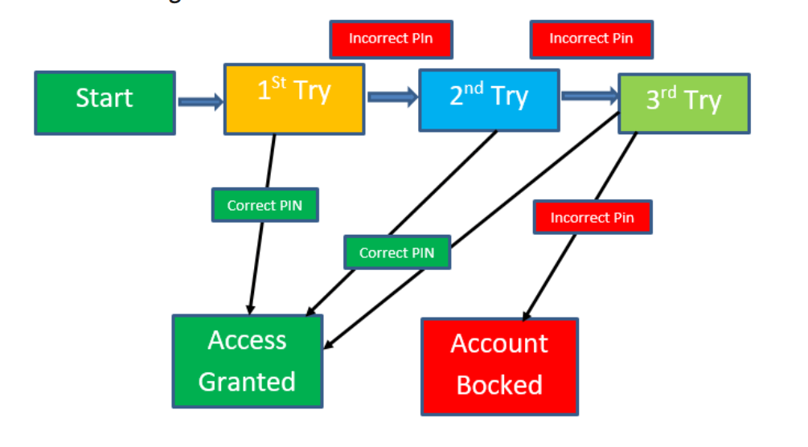

Slide 10
State Transition Table
State | Insert Card | Correct Pin | Incorrect pin
S1 | S2 | - | -
S2 | - | S5 | S3
S3 | - | S5 | S4
S4 | - | S5 | S6
S5 | - | - | -
S6 | - | - | -

Slide 11
Advantages
Disadvantages
This testing technique will provide a pictorial or tabular representation of system behavior which will make the tester to cover and understand the system behavior effectively.
By using this testing, technique tester can verify that all the conditions are covered, and the results are captured
The main disadvantage of this testing technique is that we can't rely in this technique every time. For example, if the system is not a finite system (not in sequential order), this technique cannot be used.
Another disadvantage is that you have to define all the possible states of a system. While this is all right for small systems, it soon breaks down into larger systems as there is an exponential progression in the number of states.

Slide 12
Summary
State Transition testing is defined as the testing technique in which changes in input conditions cause's state changes in the Application under Test.
In Software Engineering, State Transition Testing Technique is helpful where you need to test different system transitions.
Two main ways to represent or design state transition, State transition diagram, and State transition table.
In state transition diagram the states are shown in boxed texts, and the transition is represented by arrows.
In state transition table all the states are listed on the left side, and the events are described on the top.
This main advantage of this testing technique is that it will provide a pictorial or tabular representation of system behavior which will make the tester to cover and understand the system behavior efficiently.
The main disadvantage of this testing technique is that we can't rely in this technique every time.

Slide 13
Mutation Testing
Mutation Testing is a type of software testing in which certain statements of the source code are changed/mutated to check if the test cases are able to find errors in source code. The goal of Mutation Testing is ensuring the quality of test cases in terms of robustness that it should fail the mutated source code.
The changes made in the mutant program should be kept extremely small that it does not affect the overall objective of the program. Mutation Testing is also called Fault-based testing strategy as it involves creating a fault in the program and it is a type of White Box Testing which is mainly used for Unit Testing.

Slide 14
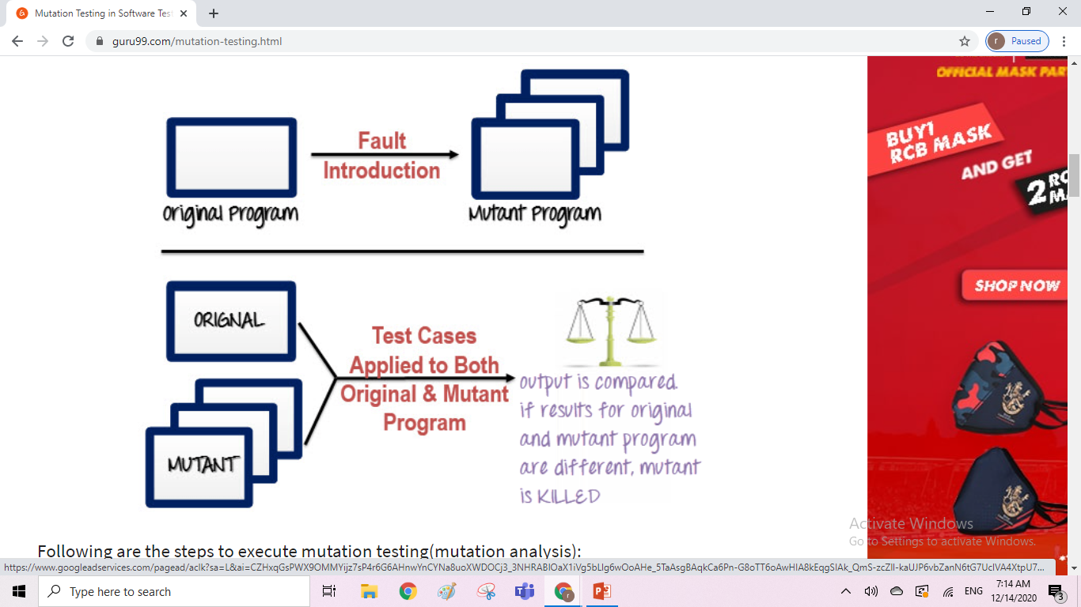
How to execute Mutation Testing?

Slide 15
Following are the steps to execute mutation testing(mutation analysis):
Step 1: Faults are introduced into the source code of the program by creating many versions called mutants. Each mutant should contain a single fault, and the goal is to cause the mutant version to fail which demonstrates the effectiveness of the test cases.
Step 2: Test cases are applied to the original program and also to the mutant program. A Test Case should be adequate, and it is tweaked to detect faults in a program.
Step 3: Compare the results of an original and mutant program.
Step 4: If the original program and mutant programs generate the different output, then that the mutant is killed by the test case. Hence the test case is good enough to detect the change between the original and the mutant program.
Step 5: If the original program and mutant program generate the same output, Mutant is kept alive. In such cases, more effective test cases need to be created that kill all mutants.

Slide 16
How to Create Mutant Programs?
A mutation is nothing but a single syntactic change that is made to the program statement. Each mutant program should differ from the original program by one mutation.
Original Program | Mutant Program
If (x>y) Print "Hello" Else Print "Hi" | If(x<y) Print "Hello" Else Print "Hi"

Slide 17
Techniques to create mutant program
Operand replacement operators
Expression Modification Operators
Statement modification Operators

Slide 18
Operand replacement operators
Replace the operand with another operand (x with y or y with x) or with the constant value.
Example- If(x>y) replace x and y values If(5>y) replace x by constant 5

Slide 19
Expression Modification Operators
Replace an operator or insertion of new operators in a program statement.
Example- If(x==y) We can replace == into >= and have mutant program as If(x>=y) and inserting =+ in the statement If(x=+y)

Slide 20
Statement modification Operators
Programmatic statements are modified to create mutant programs.
Example- Delete the else part in an if-else statement Delete the entire if-else statement to check how a program behaves
Some of sample mutation operators:
GOTO label replacement
Return statement replacement
Statement deletion
Unary operator insertion (Like - and ++)
Logical connector replacement
Comparable array name replacement
Removing of else part in the if-else statement
Adding or replacement of operators

Slide 21
Automation of Mutation Testing:
Mutation testing is extremely time consuming and complicated to execute manually. To speed up the process, it is advisable to go for automation tools. Automation tools reduce the cost of testing as well.
List of tools available -
Stryker
PIT Testing

Slide 22
Types of Mutation Testing
In Software Engineering, Mutation testing could be fundamentally categorized into 3 types–
Statement Mutation - developer cut and pastes a part of a code of which the outcome may be a removal of some lines
Value Mutation- values of primary parameters are modified
Decision Mutation- control statements are to be changed

Slide 23
Mutation Score:
The mutation score is defined as the percentage of killed mutants with the total number of mutants.
Mutation Score = (Killed Mutants / Total number of Mutants) * 100
Test cases are mutation adequate if the score is 100%. Experimental results have shown that mutation testing is an effective approach for measuring the adequacy of the test cases. But, the main drawback is that the high cost of generating the mutants and executing each test case against that mutant program.

Slide 24
Advantages of Mutation Testing:
It is a powerful approach to attain high coverage of the source program.
This testing is capable comprehensively testing the mutant program.
Mutation testing brings a good level of error detection to the software developer.
This method uncovers ambiguities in the source code and has the capacity to detect all the faults in the program.
Customers are benefited from this testing by getting a most reliable and stable system.

Slide 25
Disadvantages of Mutation Testing:
Mutation testing is extremely costly and time-consuming since there are many mutant programs that need to be generated.
Since its time consuming, it's fair to say that this testing cannot be done without an automation tool.
Each mutation will have the same number of test cases than that of the original program. So, a large number of mutant programs may need to be tested against the original test suite.
As this method involves source code changes, it is not at all applicable for Black Box Testing.

